Slide 1
DATA ANALYTICS AIRLINE DATA ANALYTICS FOR AVIATION INDUSTRY

Slide 2
TEAM MEMBERS:
SINEKA.V
VINOTHINI.P
SRUTHI.R
THARANI.E

Slide 3
PROJECT DEVELOPMENT PHASE
SPRINT 1
COLLECTING THE DATA
UPOADING THE DATA
PREPARING THE DATA
SPRINT 2
EXPLORATION OF DATA
PRESENTATION OF DATA
SPRINT 3
CREATING INTERATIVE DASHBOARD WITH EXCLUSIVE GRAPHICAL REPRESENTATION
SPRINT 4
REPORT CREATION AND STORY CREATION

Slide 4
SPRINT 4
PART - 1
REPORT CREATION

Slide 5
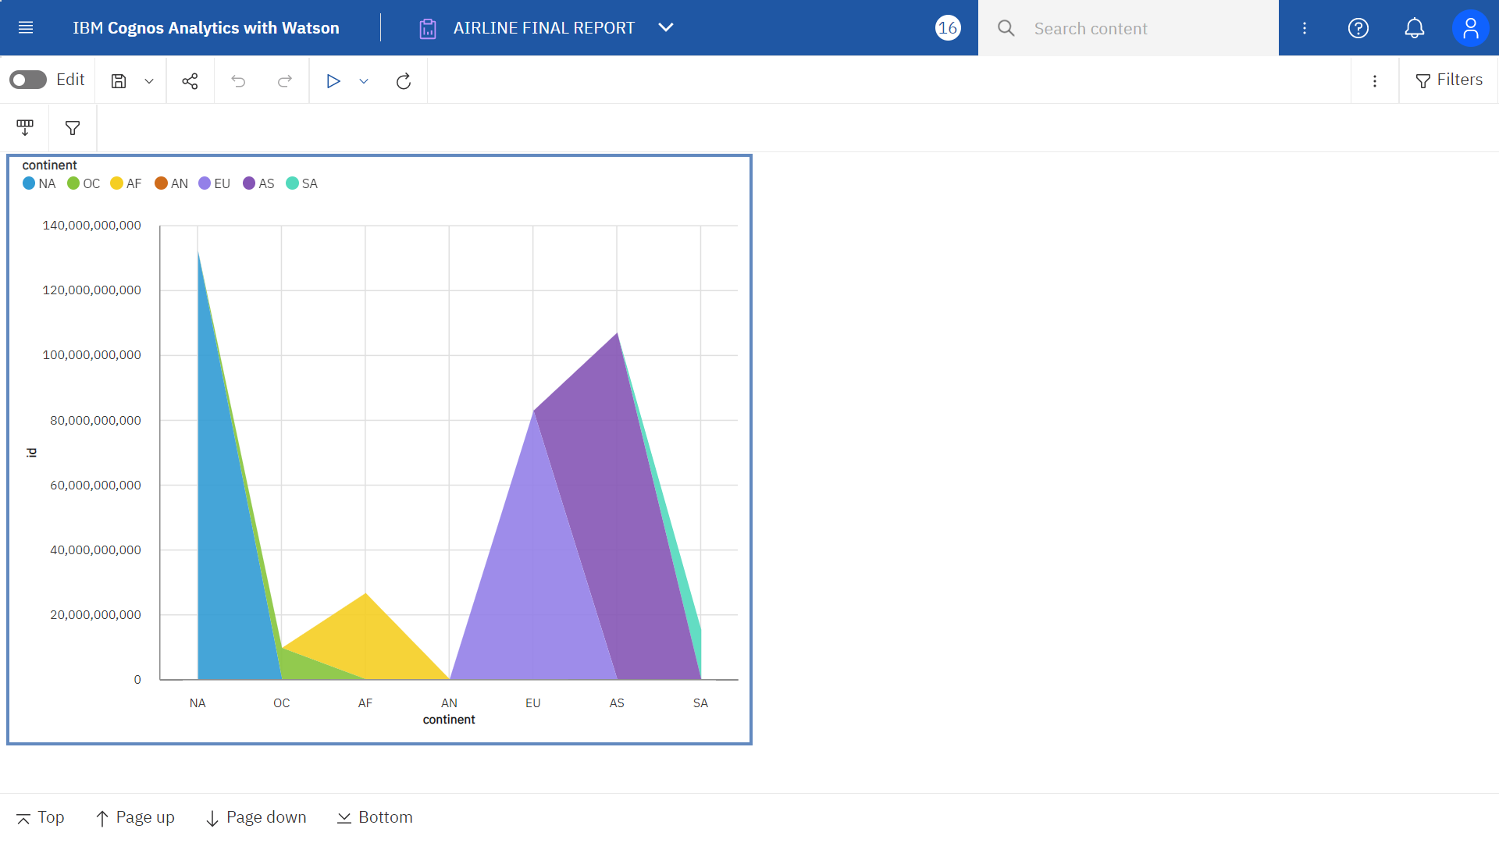

Slide 6
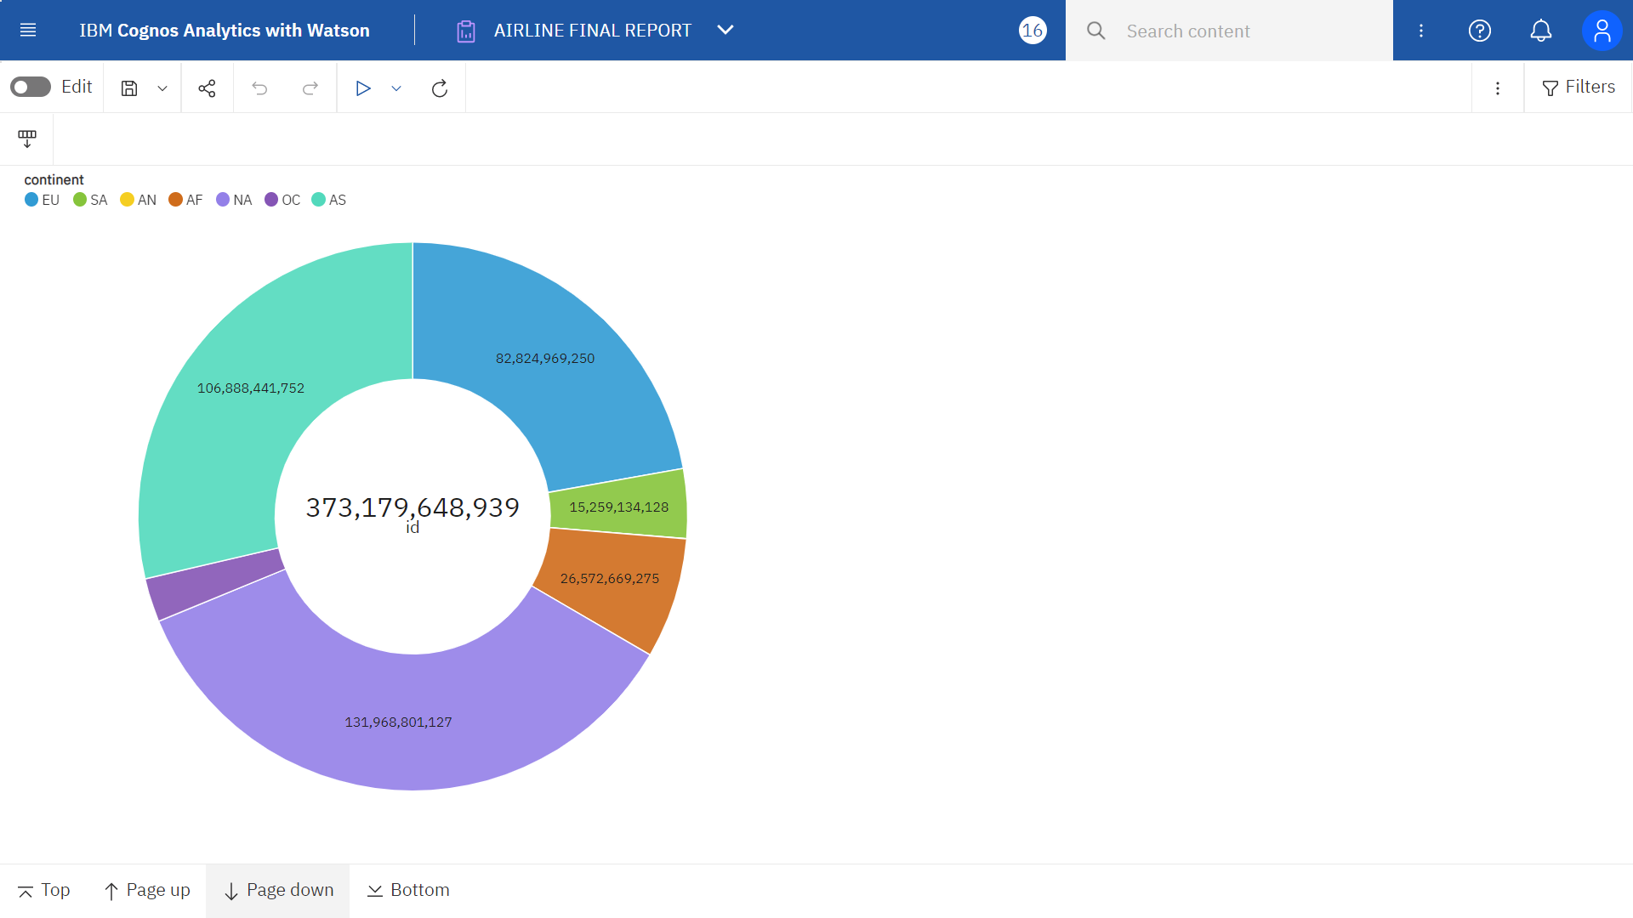

Slide 7
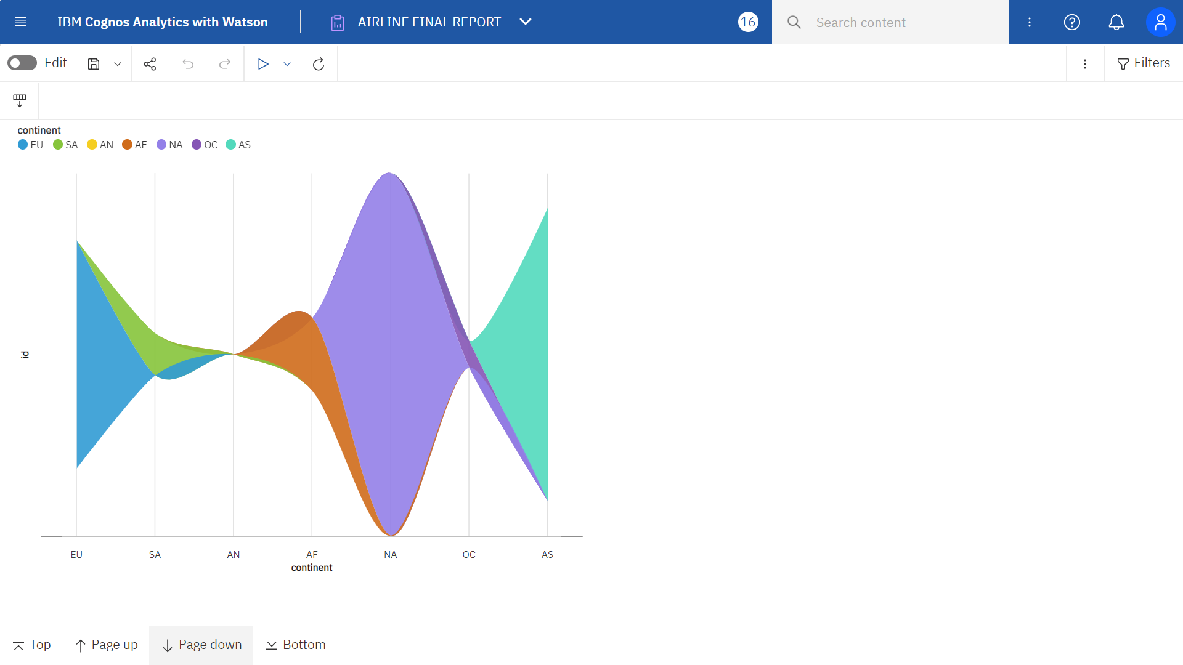
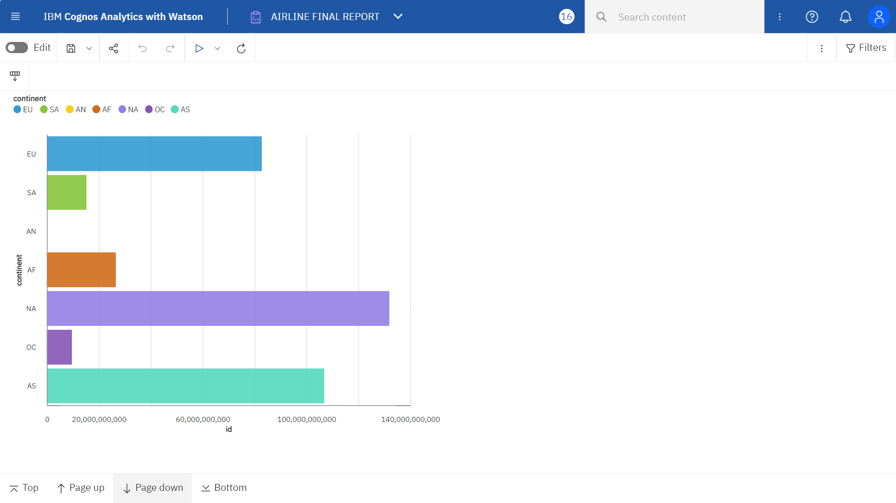

Slide 9
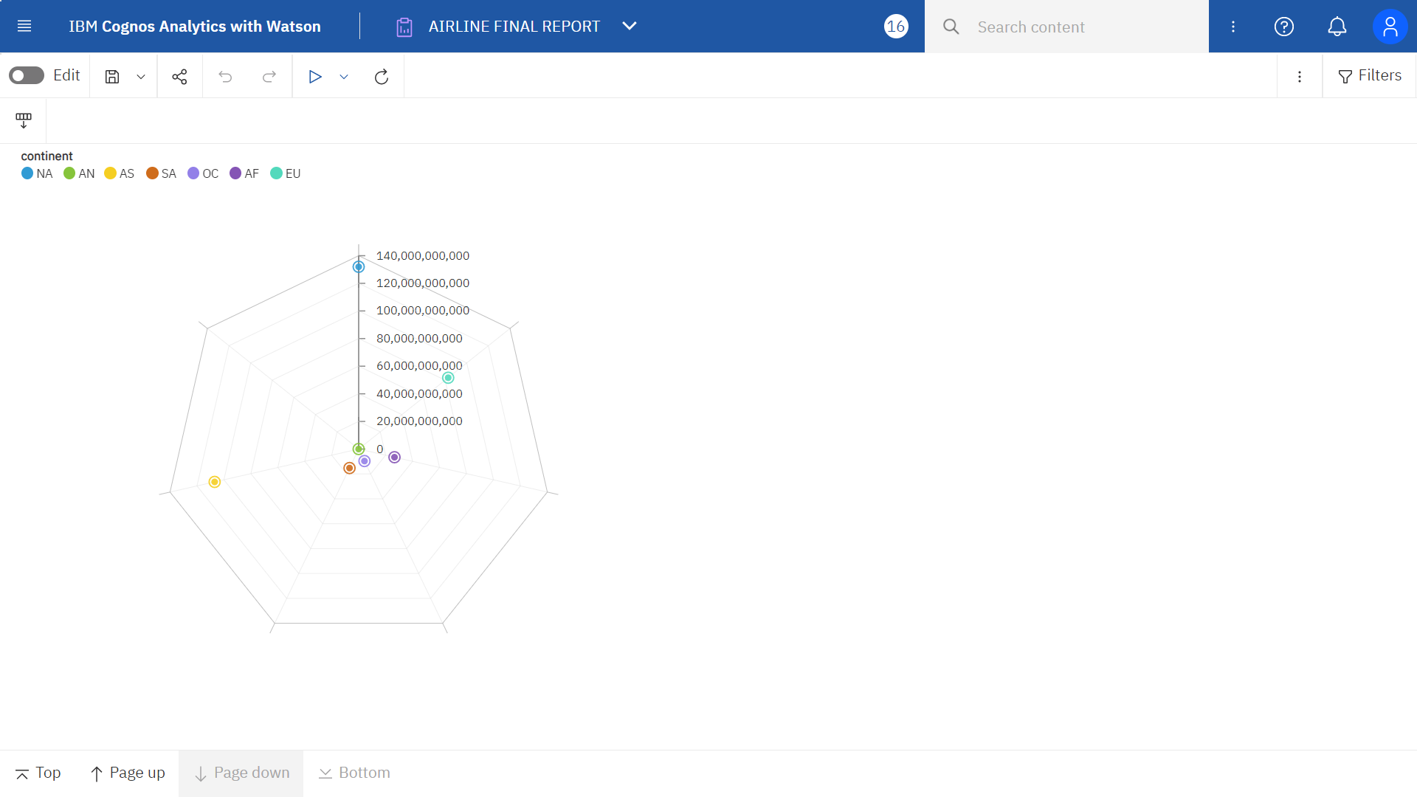

Slide 10
SPRINT 4
PART - 2
STORY CREATION

Slide 11
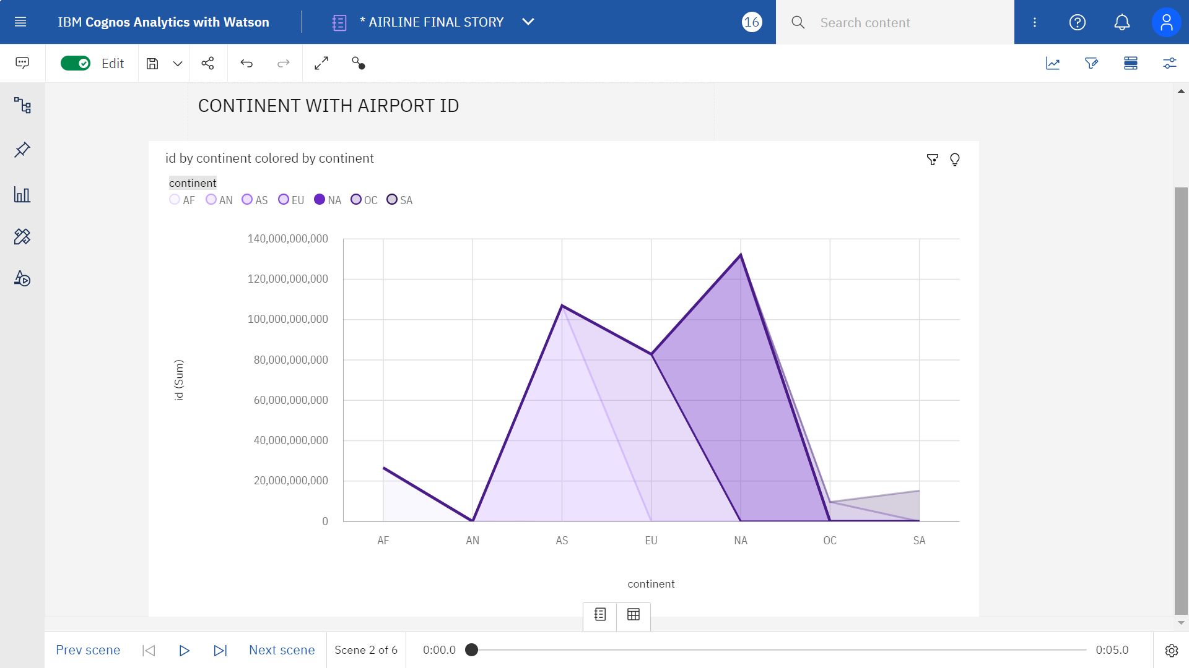

Slide 12
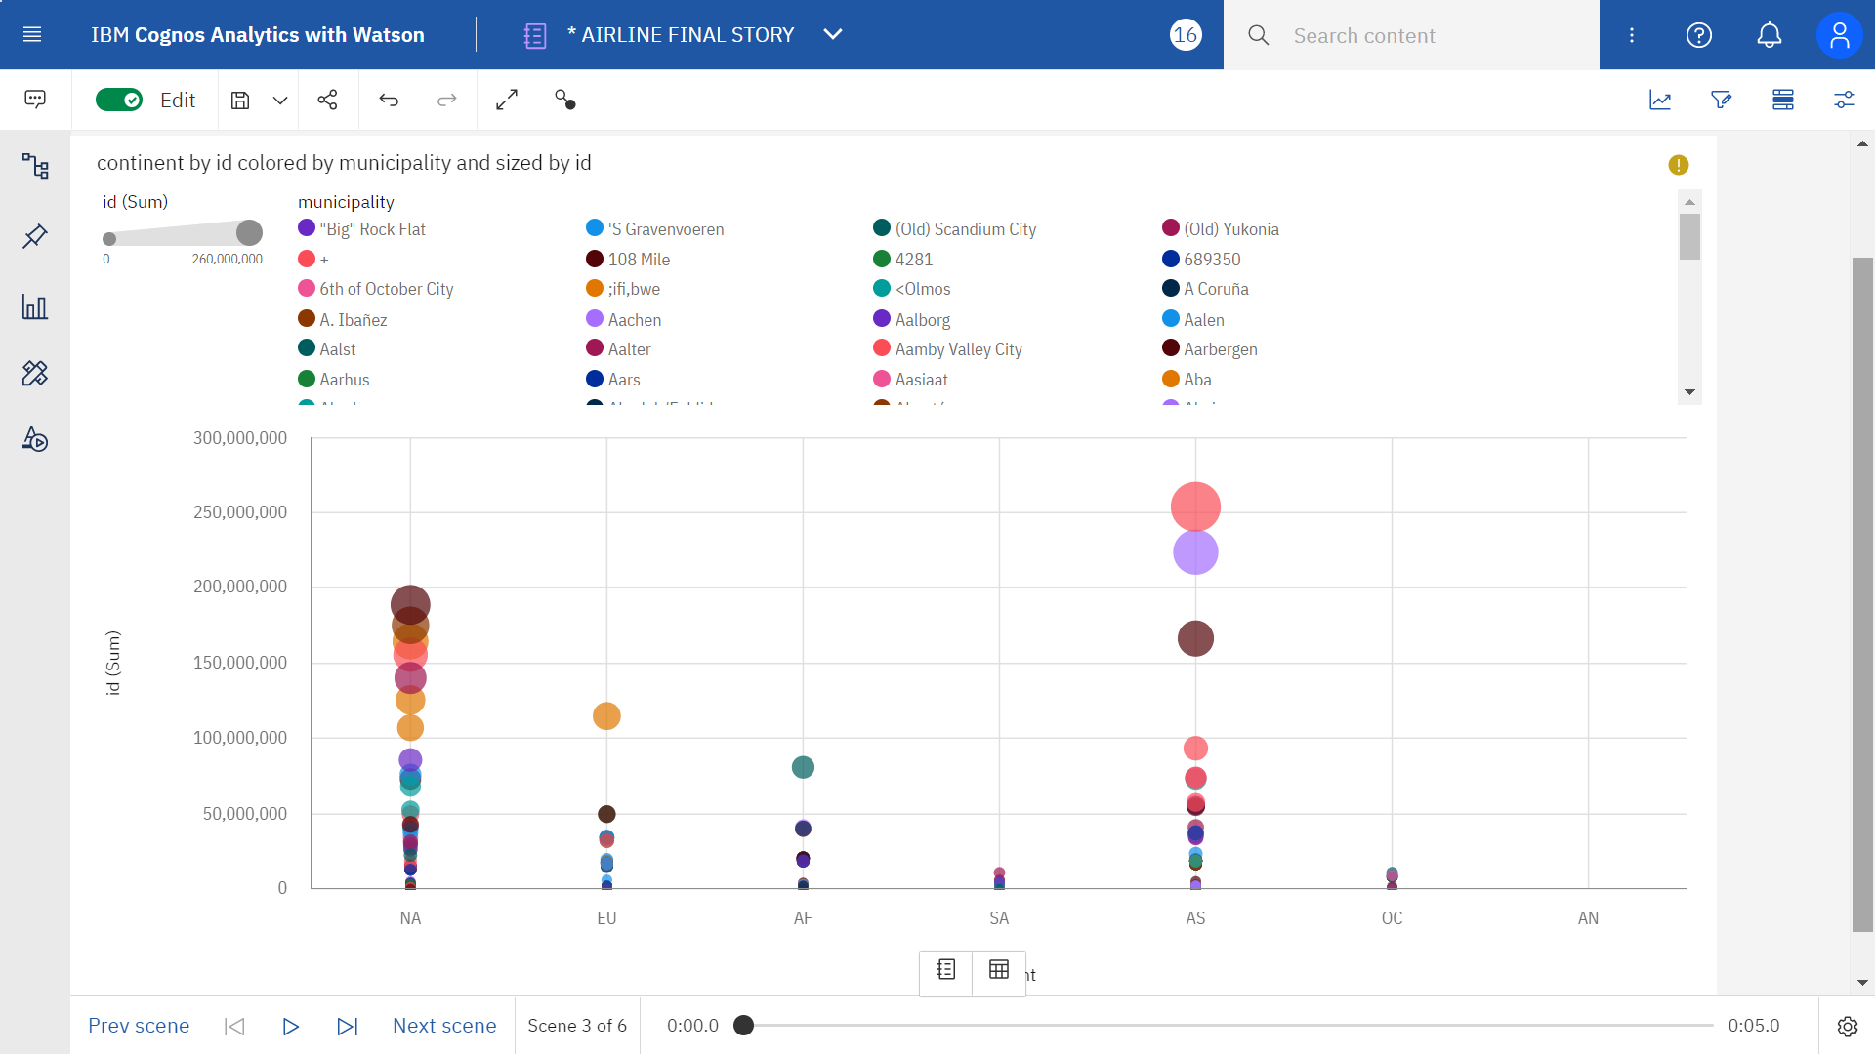

Slide 13
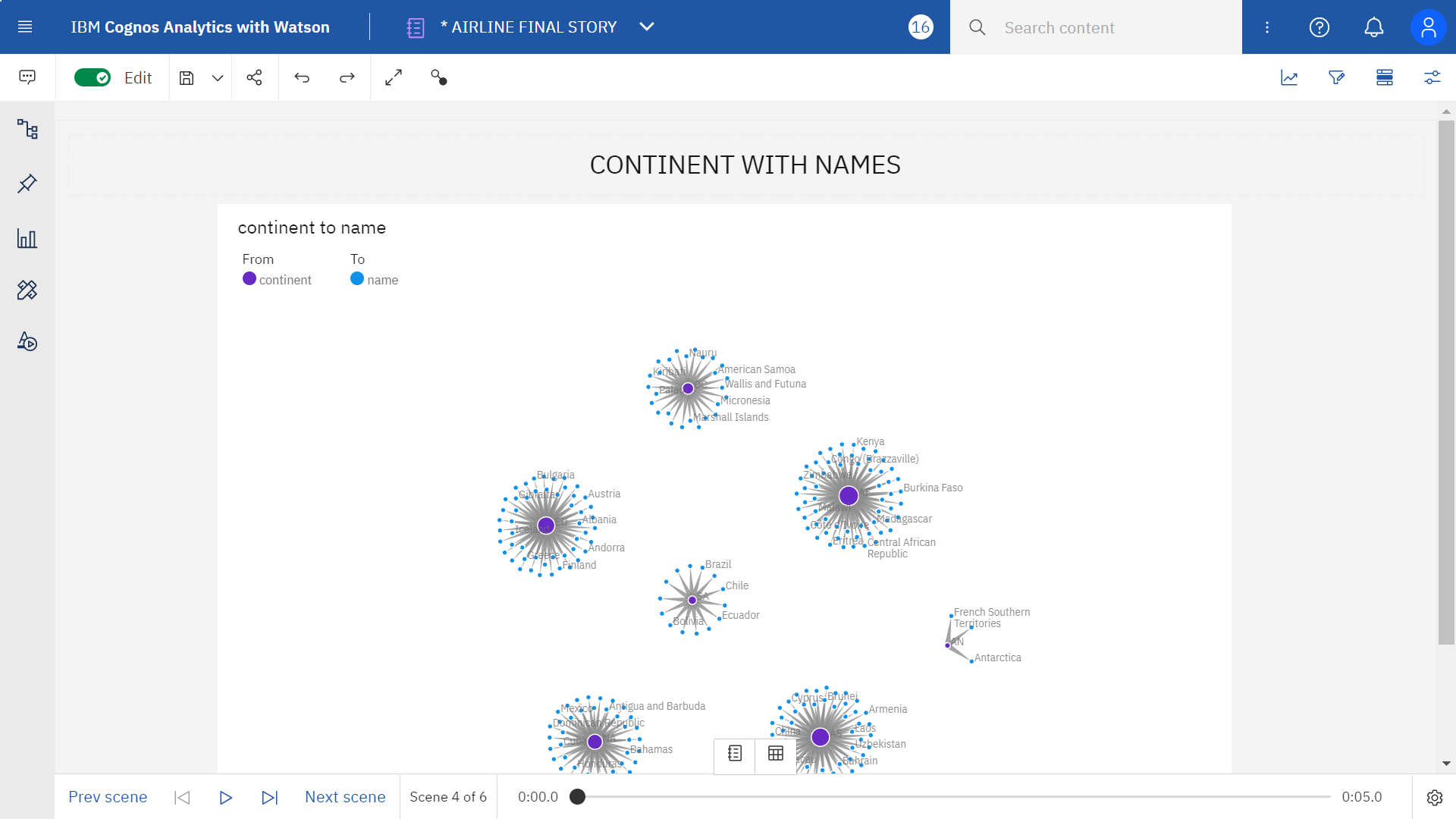

Slide 14
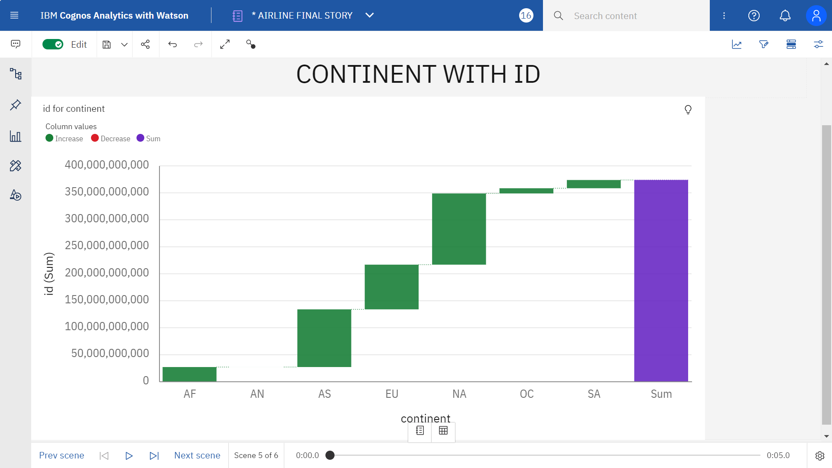

Slide 15
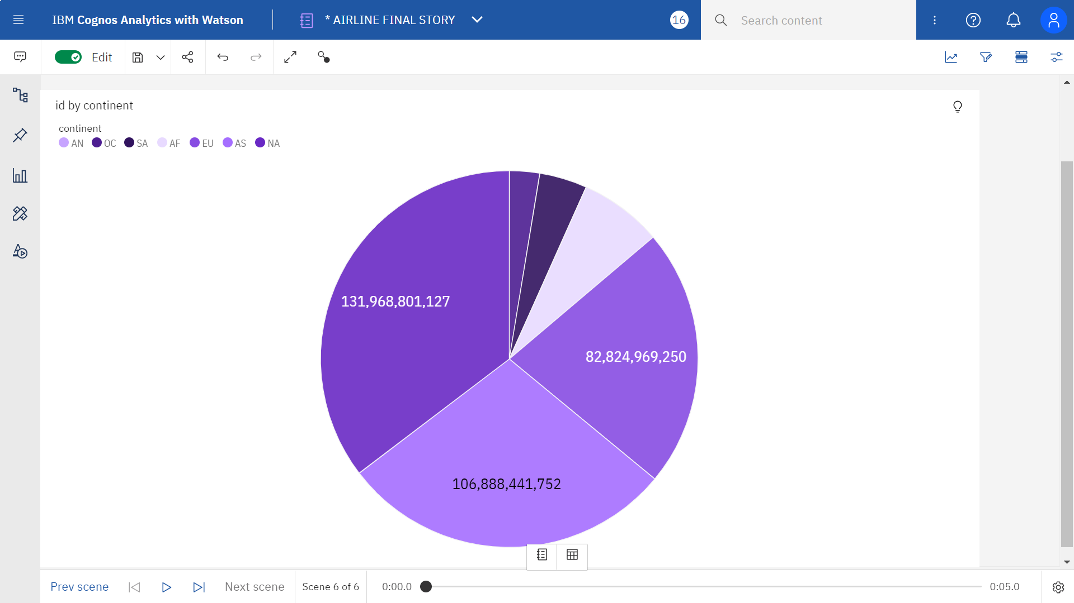

Slide 16
THANK YOU

